Slide 1




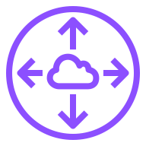

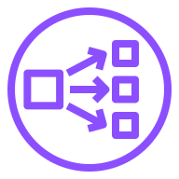



Bedrock Multi-region Architecture
US Virginia Region
Customer Account
Seoul Region
Bedrock VPC
Customer Account
AWS Bedrock Account
Intra
Subnet
Private Subnet
Workload VPC
Private Subnet
Seoul
VPC Peering
Runtime
VPC Endpoint
(virginia.runtime
.bedrock.in)
Runtime
Endpoint
Bedrock
Workload
Private
Hosted Zone
(bedrock.in)
US Oregon Region
Customer Account
Intra Subnet
Bedrock VPC
AWS Bedrock Account
Intra
Subnet
Private Subnet
US Virginia
VPC Peering
US Oregon
VPC Peering
Seoul
VPC Peering
Runtime
VPC Endpoint
(oregon.runtime
.bedrock.in)
Runtime
Endpoint
Bedrock

Slide 2
Disable SSL Certificate Verification
Seoul Region
US Virginia Region
Customer Account
Customer Account
Bedrock VPC
AWS Bedrock Account
Workload VPC
Intra
Subnet
Private Subnet
Private Subnet
Seoul
VPC Peering
Runtime
VPC Endpoint
(virginia.runtime
.bedrock.in)
Runtime Endpoint
(bedrock-runtime
.us-east-1.amazonaws.com
Certi : amazonaws.com)
Bedrock
Workload
Private
Hosted Zone
(bedrock.in)
Intra Subnet
US Virginia
VPC Peering

Slide 4
Amazon Bedrock Endpoint Access
우아한형제들
신 정 섭 (ssupp@amazon.com)
AWS Solutions Architect

Slide 5
Agenda
Bedrock Endpoints
Bedrock Multi-region Architecture

Slide 6
Bedrock Endpoints

Slide 7


Bedrock Architecture
AWS Cloud
Seoul Region
Bedrock API 호출을 통해서 추론 수행
IAM을 이용한 Bedrock 권한 획득 필요
External Client : Public Endpoint를 통해서 Bedrock 접근
Internal Client : VPC Endpoint를 통해서 Bedrock 접근
Customer Account
AWS Bedrock Account
Internal
Client
Bedrock
VPC Endpoint
Bedrock
Endpoint
Bedrock
External
Client

Slide 8
Bedrock Endpoint
Control Plane API
Bedrock 제어 수행
bedrock.[region].amazonaws.com
Runtime API
Bedrock Model에게 추론 요청
bedrock-runtime.[region].amazonaws.com
Agent Build-time API
Bedrock Agent 설정, 제어 수행
bedrock-agent.[region].amazonaws.com
Agent Runtime API
bedrock-agent-runtime.[region].amazonaws.com
Bedrock Agent 호출

Slide 9

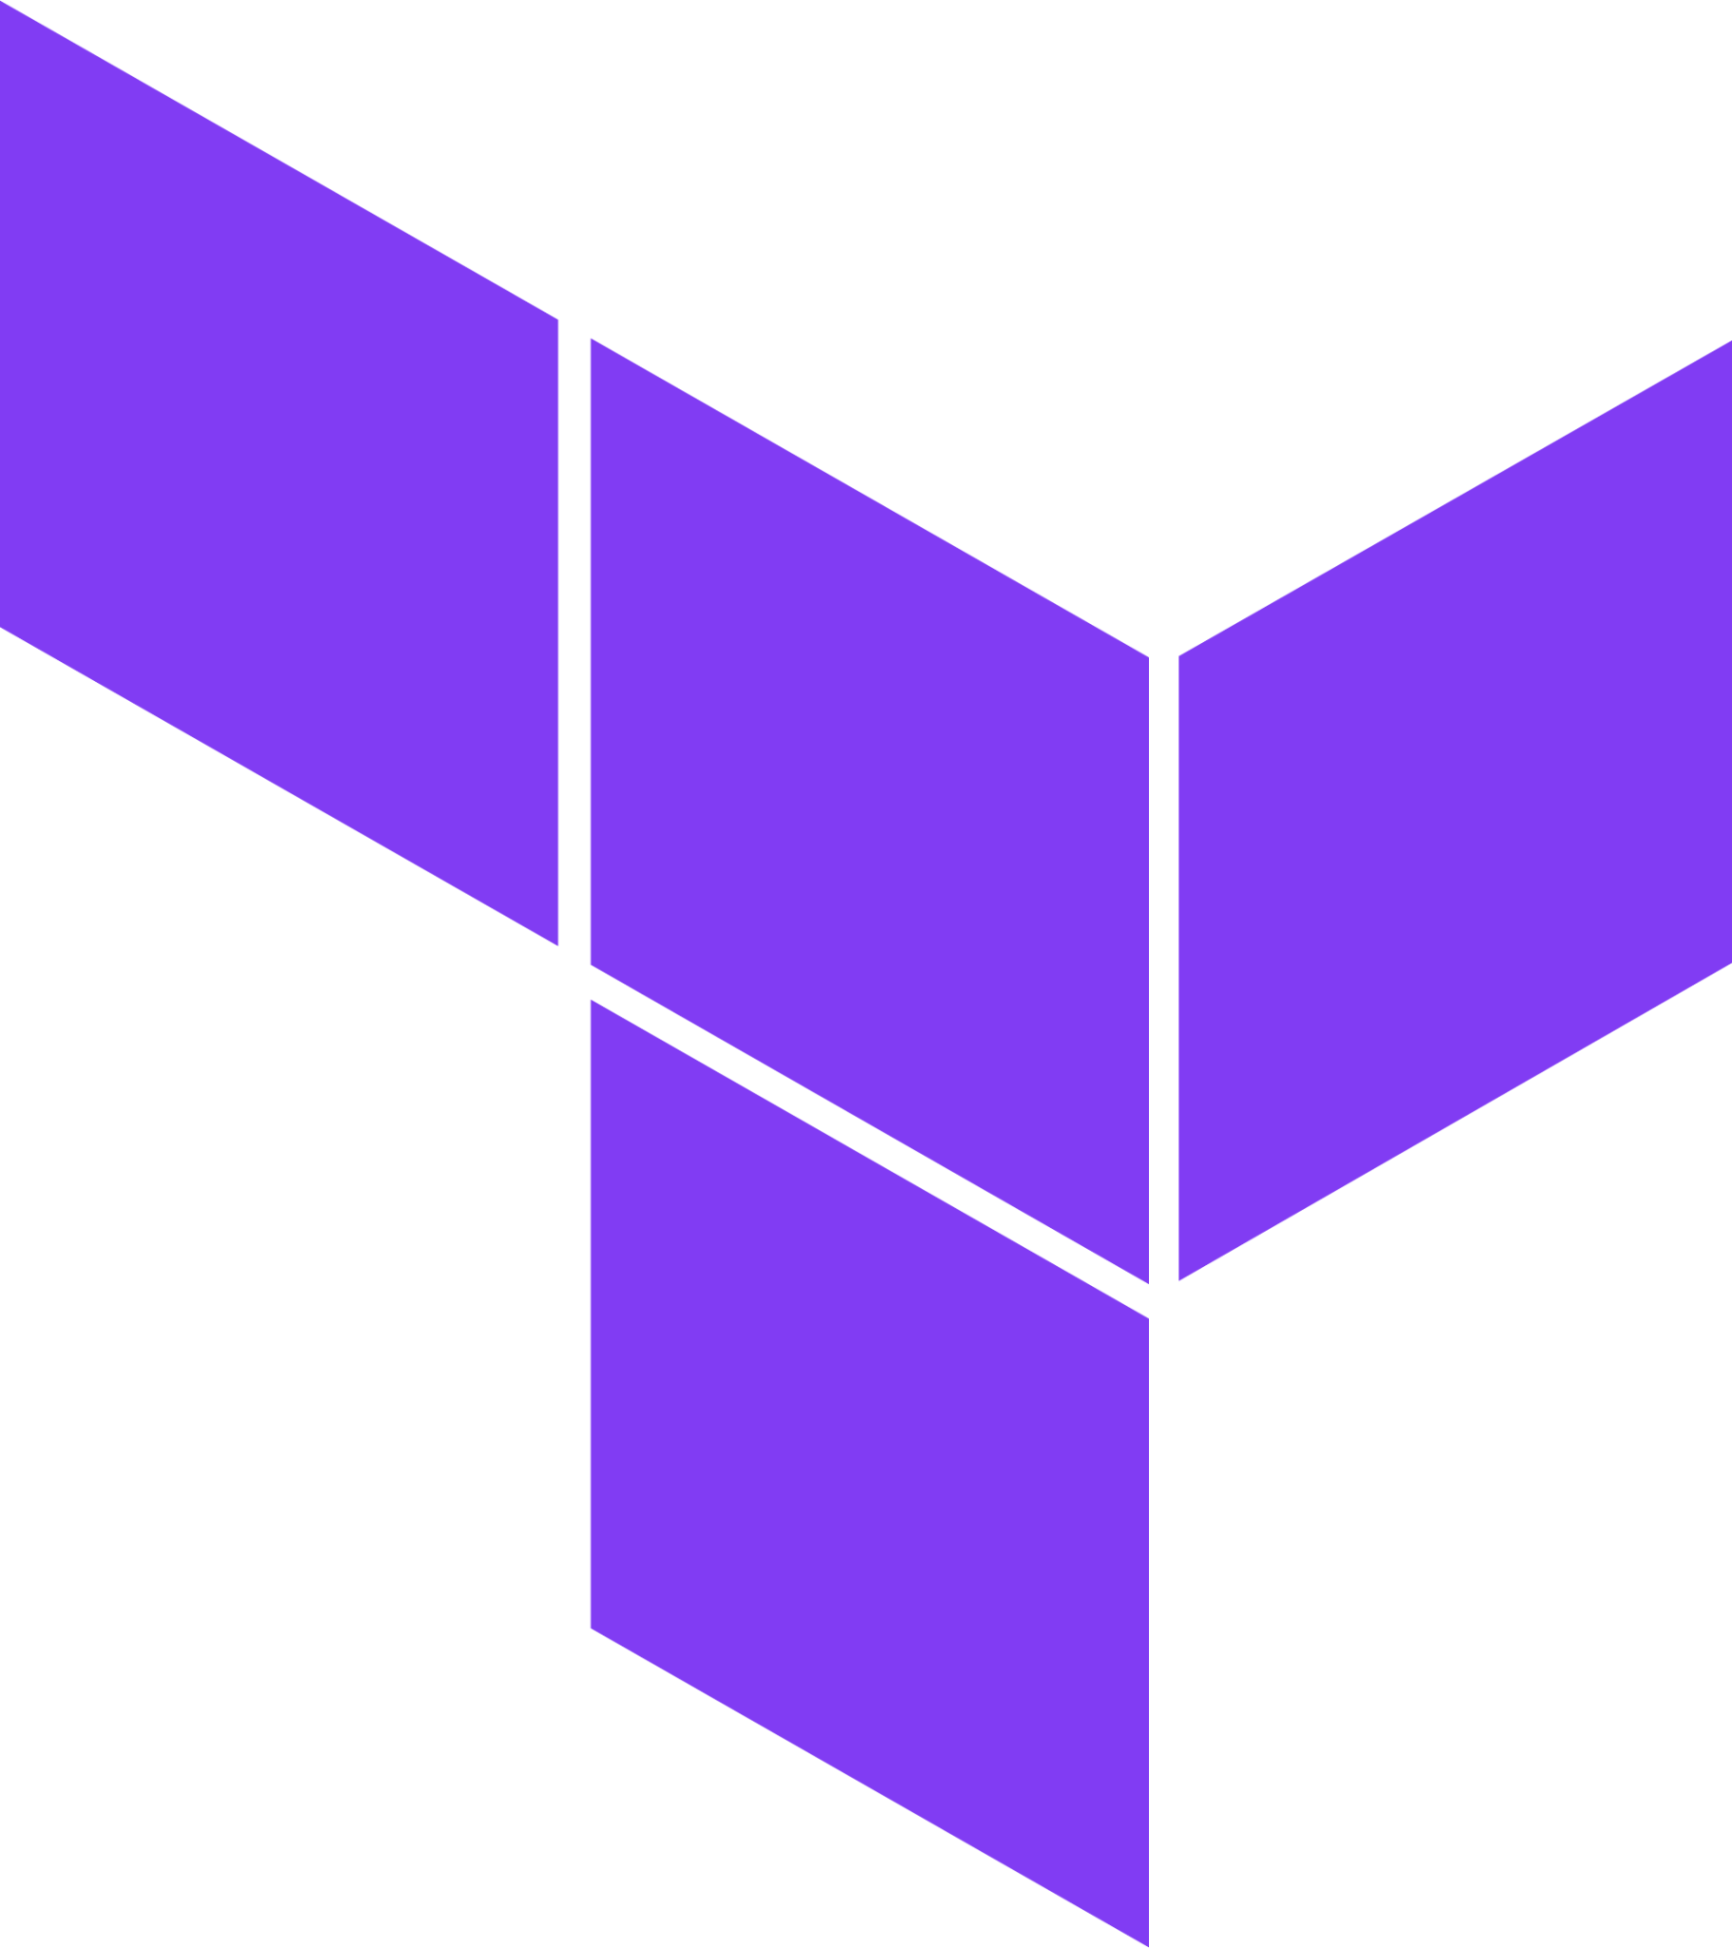
Bedrock Architecture with Endpoints
AWS Cloud
Seoul Region
AWS
Console
Customer Account
AWS Bedrock Account
Cloud
Formation
Workload
Bedrock Runtime
VPC Endpoint
Control Plane
Endpoint
Terraform
Bedrock Agent
Runtime
VPC Endpoint
Agent Build-time
Endpoint
Bedrock
추론을 수행하는 Bedrock Endpoint는 VPC Endpoint 생성 필요
Runtime Endpoint
Agent Runtime Endpoint
Runtime
Endpoint
Agent Runtime
Endpoint

Slide 10
Bedrock VPC Endpoint Policy
{
"Version": "2012-10-17",
"Statement": [
{
"Principal": "*",
"Effect": "Allow",
"Action": [
"bedrock:InvokeModel",
"bedrock:InvokeModelWithResponseStream"
],
"Resource":"*"
}
]
}
Bedrock Invoke API만 호출 하도록 제한

Slide 11
Bedrock Multi-region Architecture

Slide 12
Why Multi-region ?
Pros
서울 Region의 부족한 Bedrock 리소스 보충
Cons
Private Network 구성시, 각 Region 별로 별도의 Network 구성 필요
API Quota 추가 확보 가능 (각 Region별로 별도의 API Quota 적용)
물리적 거리에 따른 Latency 발생

Slide 13
Bedrock Multi-region Architecture
US Virginia Region
Customer Account
Seoul Region
Bedrock VPC
Customer Account
AWS Bedrock Account
Intra
Subnet
Private Subnet
Workload VPC
Private Subnet
Seoul
VPC Peering
Runtime
VPC Endpoint
(virginia.runtime
.bedrock.in)
Runtime
Endpoint
Bedrock
Private Hosted Zone을 이용하여 다른 Region의 Bedrock Runtime Endpoint에 접근
VPC Peering은 Transit Gateway로 대체 가능
Workload에서 Region Load Balancing 수행
Workload
Private
Hosted Zone
(bedrock.in)
US Oregon Region
Customer Account
Intra Subnet
Bedrock VPC
AWS Bedrock Account
Intra
Subnet
Private Subnet
US Virginia
VPC Peering
US Oregon
VPC Peering
Seoul
VPC Peering
Runtime
VPC Endpoint
(oregon.runtime
.bedrock.in)
Runtime
Endpoint
Bedrock

Slide 14
Disable SSL Certificate Verification
Seoul Region
US Virginia Region
Customer Account
Customer Account
Bedrock VPC
AWS Bedrock Account
Workload VPC
Intra
Subnet
Private Subnet
Private Subnet
Seoul
VPC Peering
Runtime
VPC Endpoint
(virginia.runtime
.bedrock.in)
Runtime Endpoint
(bedrock-runtime
.us-east-1.amazonaws.com
Certi : amazonaws.com)
Bedrock
Workload
Private
Hosted Zone
(bedrock.in)
Intra Subnet
Client는 “Custom Domain (bedrock.in)”의 인증서를 예상하지만, 실제로는 “amazonaws.com” Domain 인증서를 전달 받기 때문에 Certification Error 발생
Client에서 Verify SSL 설정 Disable
AWS CLI : --no-verfiy-ssl --endpoint-url " https://virginia.runtime.bedrock.in”
Python Boto3 : client(verify=false, endpoint_url=https://virginia.runtime.bedrock.in)
US Virginia
VPC Peering

Slide 15
Q & A

